Slide 1
Superstore Profit analysis
Donal Gonsalves

Slide 2
SUMMARY
Objective
Approach
Outcome
To discover opportunities, offer tools and suggestions to assist management in reaching goals and expanding the business.
Analyze data, derive insights & propose business strategies.
User-friendly dashboard with all KPIs to give management better decision making.

Slide 3
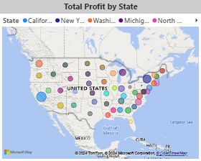
Key insights
California contributed the highest revenue of $ 89015 K, whereas New York is the second largest contributor of $ 56045 K.

Slide 4
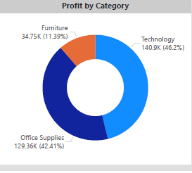
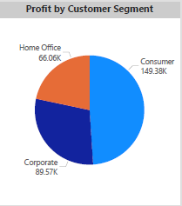
Key insights
Approx 89% ($ 270.26 K) of total revenue is generated through Technology & Office supplies, whereas only 11% ($ 34.75 K) of revenue is contributed by Furniture.
Consumer segment contributes to total revenue of 50% ($ 149.38 K) from the customer segment.

Slide 5
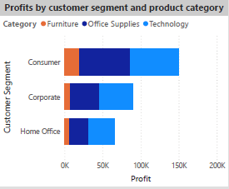
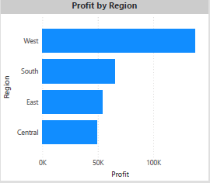
Key insights
The corporate segment is the second largest revenue contributor, and the Home Office contributes the least revenue, i.e., $ 66.06 K.
West region dominated by generating a profit of more than $100 K compared to the other regions. However, the Central region contributed the least revenue, with less than $ 50 K.

Slide 6
Recommenda-tions
Identify problems for less selling furniture items and Gain business by providing promotion offers
Advertise products to attract more customers
Tie up with other shipping companies and provide a margin of product costs based on the business given
Ship products faster into different regions
Identify products generating revenue in negative and improve the product's quality and price.

Slide 7
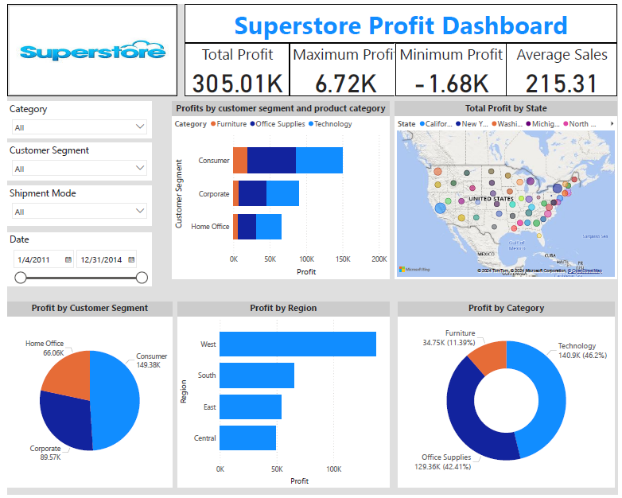
Dashboard

Slide 8
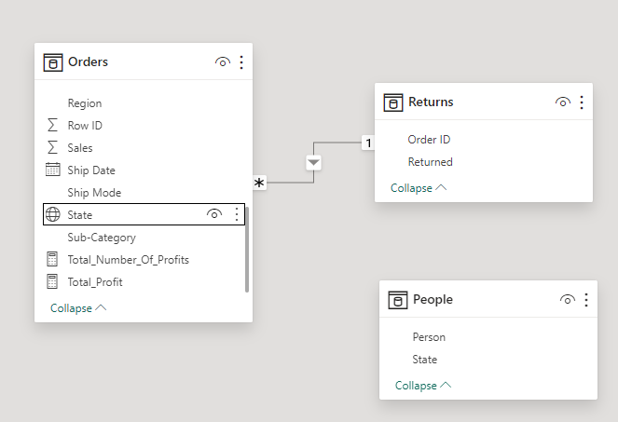
Data model

Slide 9
Thank You

